Slide 1
Complaint Redressal System

Slide 2
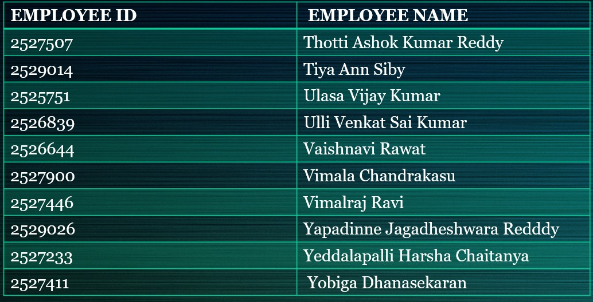
Team Members

Slide 3
Index
Introduction
Project Details
Tools & Technologies
Architecture
Flow Chart
Admin Module
Manager Module
Engineer Module
Customer Module
Benefits
Conclusion

Slide 4
Project Details
Domain: Telecom
Project Objective:
To create a dynamic and responsive Java Complaint Redressal System web application for online complaint management system where the customers can raise complaints regarding their landlines and broadband services.
Background of the project:
ABC Telecom Ltd. is one of India’s major telecommunication service providers offering landline, mobile phone and Fiber optic broadband services across the country. Their customer services group is interested in providing a set of customer redressal services through the development of a new application using the state-of-art technologies such as Spring-boot for the development of java-based services, and UI using Angular and integrate them suitably, so that all the necessary services are taken care of through this application.

Slide 5
Tools And Technologies
To develop the project:
Front-End: Angular
Server-side: Spring Boot.
Back-end: MYSQL, Hibernate.
Server: Tomcat
For testing:
Unit Testing using Junit frameworks for all the functional requirements.
Functional Testing using POSTMAN for all REST end point

Slide 6
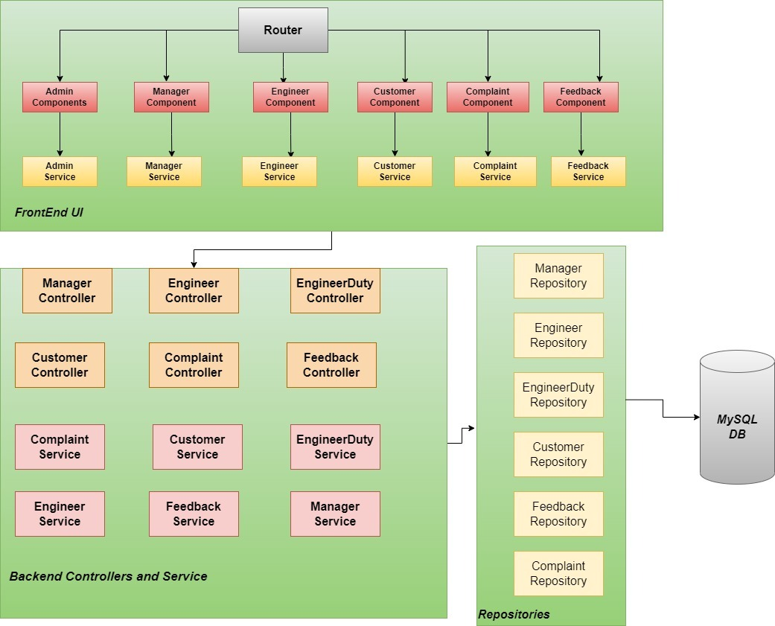
Architecture

Slide 7
Flow Chart of the Project
This project aims to create a dynamic and responsive Java Complaint Redressal System web application for online complaint management system where the customers can raise complaints regarding their landlines and broadband services.
The admin user should be able to create and manages the lifecycle of different types of Users Customer, Manager, Engineer.
The Redressal System enables the customers to login to the portal to raise and track complaints related to the services availed by them enables the manager to login, view the complaints raised by the customers and assign the ticket to the engineers based on the PIN Code Enables the engineers to pick up the tickets, work on them, enter the status of the task. They can also re assign it to the Field Workers if they cannot resolve it from the data center.
Admin user is the super user of the system. The admin user creates other categories of user like customer, manager, and engineers. The admin user has the privilege to create, update and delete the records through the web interface and can access the entire system.

Slide 8
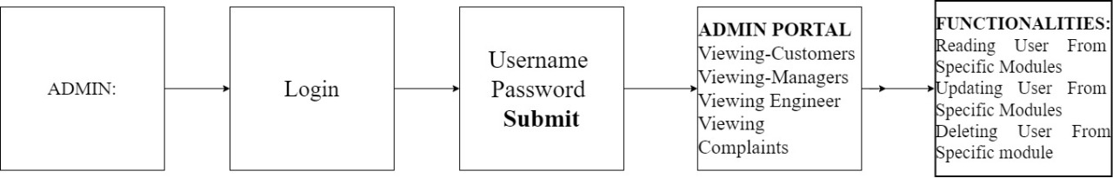
Admin Module

Slide 9
Admin Module
The admin user should be able to:
Create and manages the lifecycle of different types of users: Customer , Manager ,Engineer
Enables the customers to login to the portal to raise and track complaints related to the services availed by them.
Enables the manager to login, view the complaints raised by the customers and assign the ticket to the engineers based on the PIN Code.
Enables the engineers to pick up the tickets, work on them, enter the status of the task. They can also re-assign it to the Field Workers if they cannot resolve it from the data center.
Admin user is the super user of the system. The admin user creates other categories of user like customer, manager, and engineers. The admin user has the privilege to create, update and delete the records through the web interface and can access the entire system.
Admin Activities through UI, there has to be only one admin, and he/she can login/logout. Once logged-in, he/she should be able to maintain the lifecycles of Customer, Manager and Engineer.

Slide 10
Customer Goals
1.Register with all the required details in the portal.
2. Login using Email and password.
3. Once Login is done, customer can able to:
1.Raise or create a complaint
2.view complaints
3.providing feedback on the resolution of the complaint through the web UI.
4.The feedback provision is an optional feature.
5.Customers should provide the following minimal details such as name, address , PIN Code, mobile number and type of problem to raise a complaint.
6.Once successful submission of the complaint, a ticket is raised and shared to Manager.
7.At that time, the status of the ticket will be ‘RAISED’

Slide 11
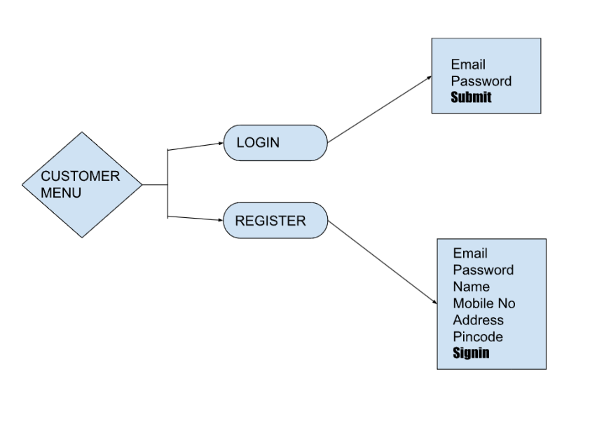
Customer Menu Functionality

Slide 12
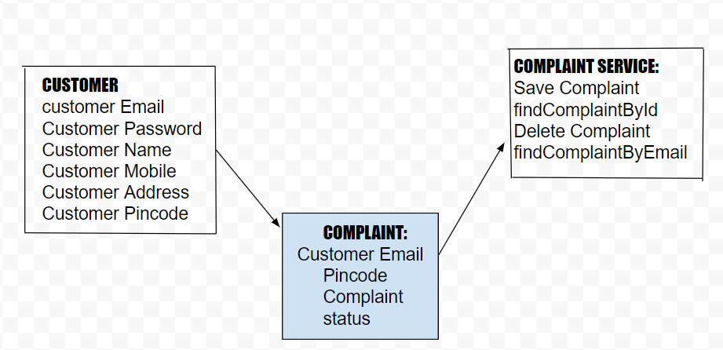
Customer Module- Complaint Schema

Slide 13
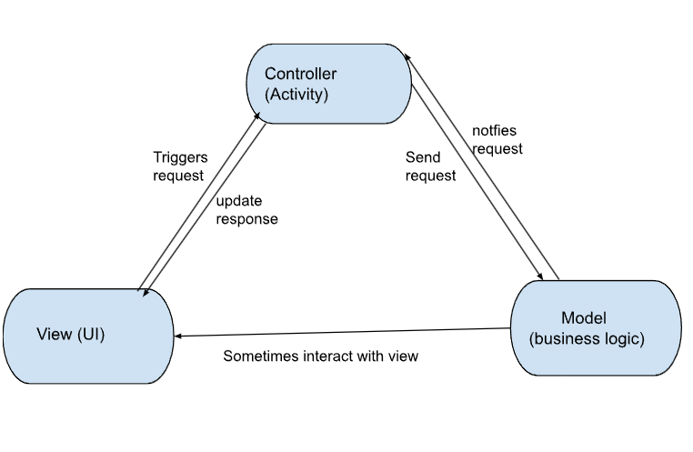
Model View Controller(MVC) Architecture

Slide 14
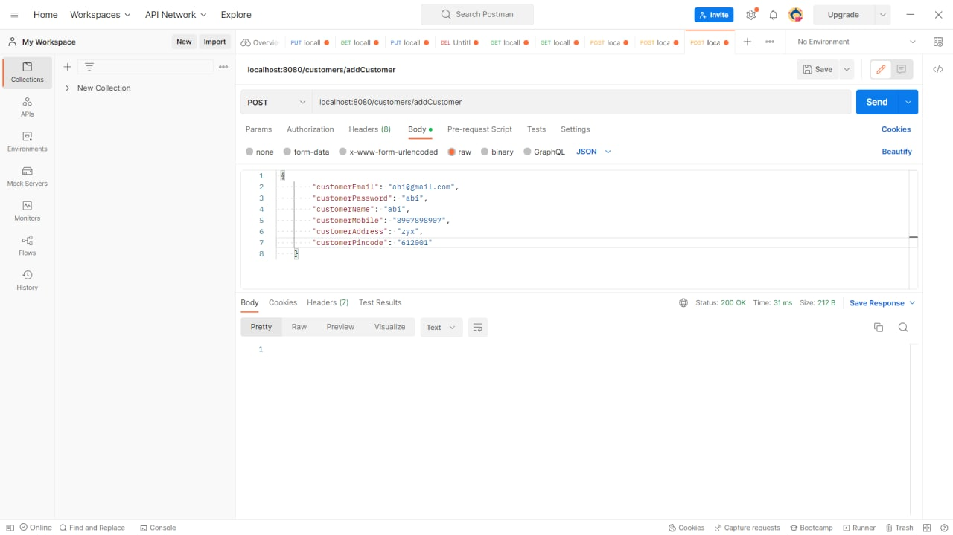
Functional Testing – Customer Module

Slide 15
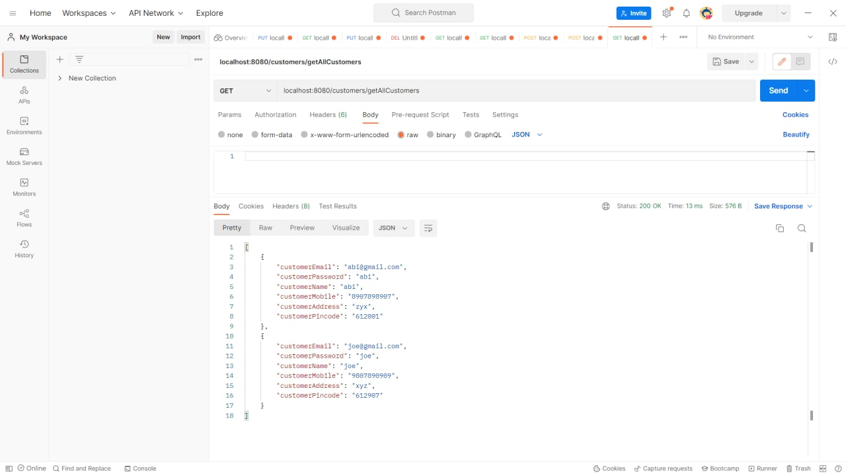

Slide 16
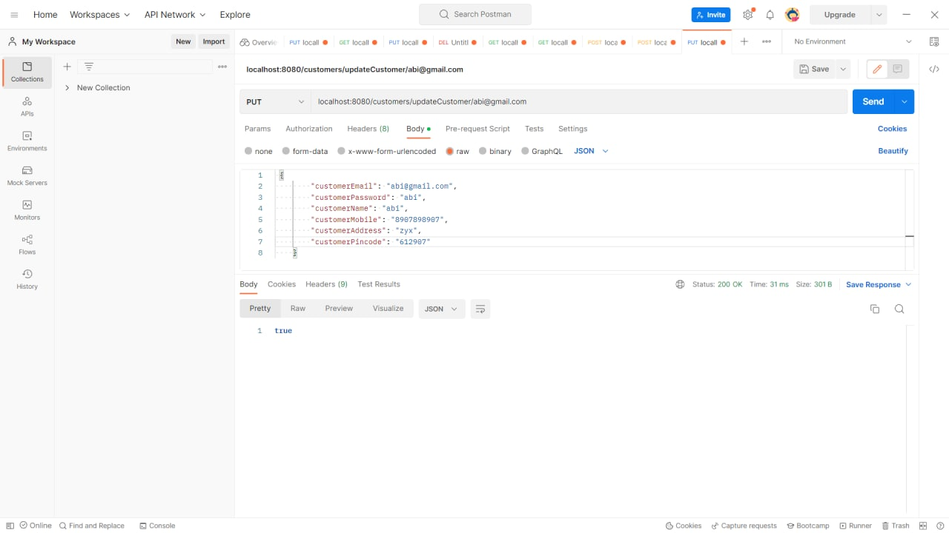

Slide 17


Slide 18
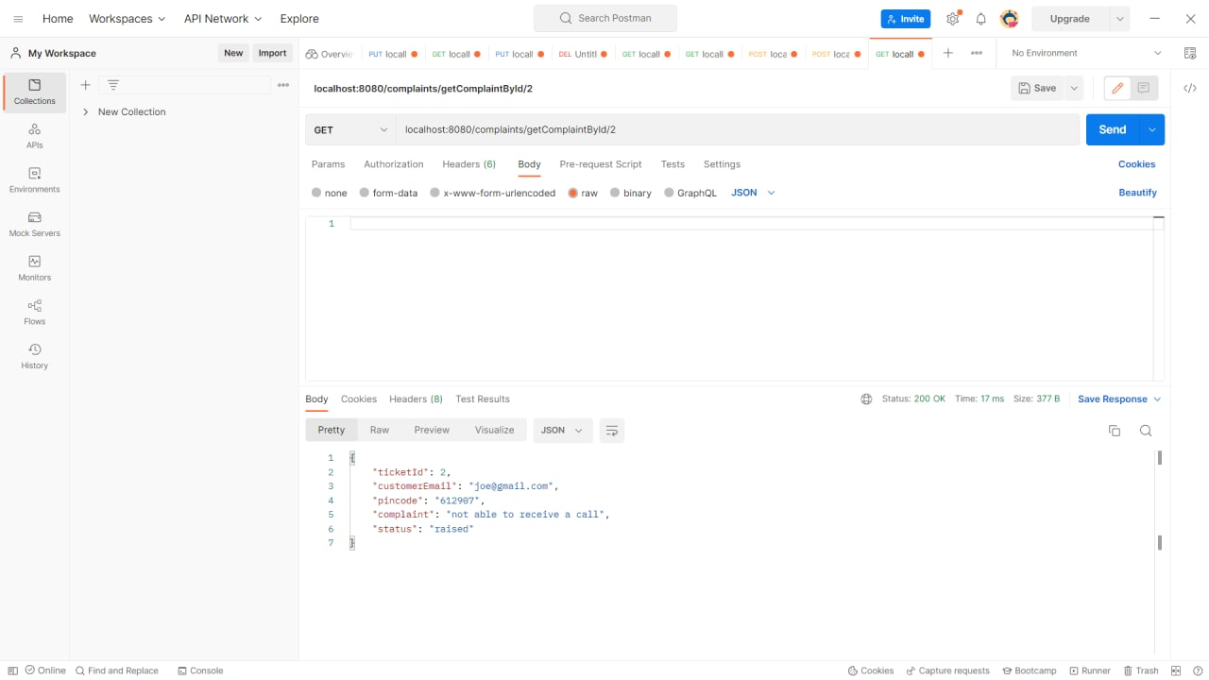

Slide 19
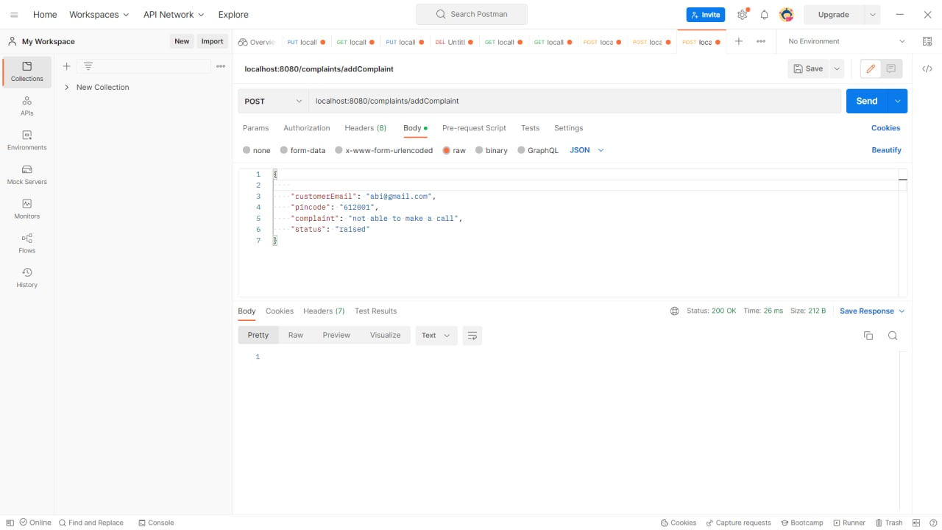

Slide 20
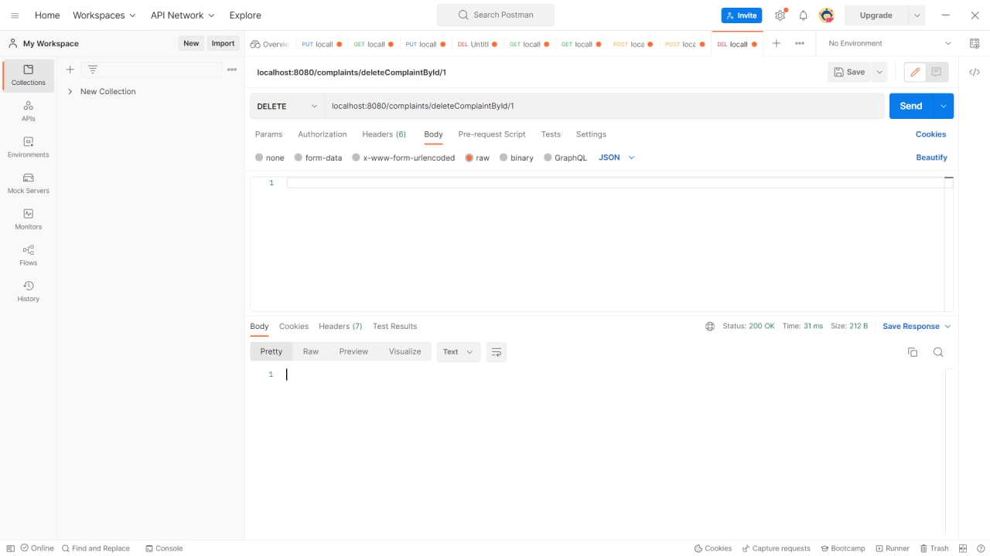

Slide 21
MANAGER MODULE:-
Online Complaint Redressal System provides an online way of solving the problems faced by the customers, Online Complaint Management is a management technique for assessing, analyzing and responding to customer complaints.
Complaints redressal system software is used to record resolve and respond to customer complaints, requests as well as facilitate any other feedback.
In our Module, Manager user is the very important role plays for complaint redressal system .
The manager user they pick the tickets from the customer raises ticket they pick active ticket list after they can do assign them to the engineers based on the PIN code of the customer.

Slide 22
MANAGER MENUFUNCTIONALITY:-
MANAGER MENU
LOGIN
REGISTER
Assign Engineers
Email
Password
Email
Password
Name
Pincode
Customer Email
Ticket Id
Complaint
Assign Engineer

Slide 23
MANAGER-COMPLAINT-ENGINEER-SCHEMA:-
COMPLAINT
Ticket Id
Customer Email
Complaint
Pincode
Status
ENGINEER
Engineer Email
Engineer Password
Engineer Name
MANAGER
Manager Email
Manager Password
Manager Name
Manager Pincode
MANAGER SERVICE
Get All Complaints by Pincode
Assign Engineer

Slide 24
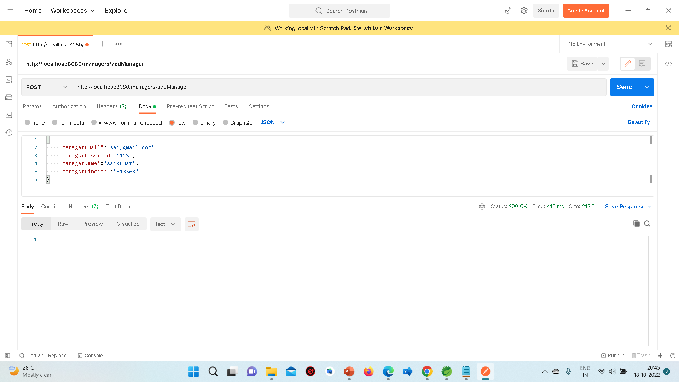
Functional Testing – Manager Module

Slide 25
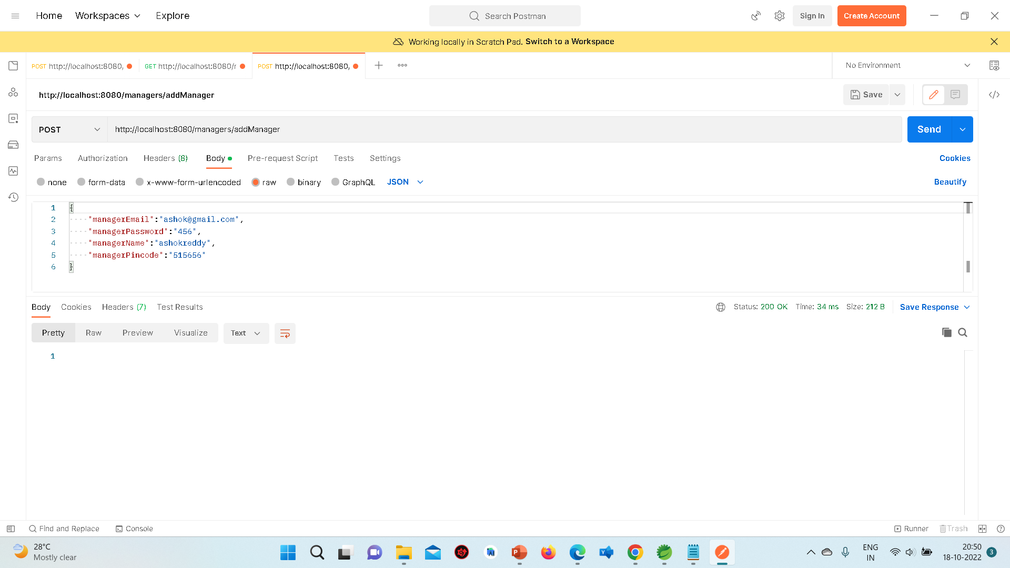

Slide 26
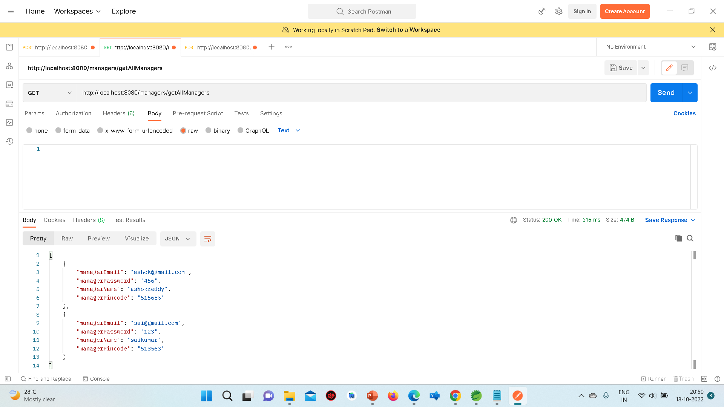

Slide 27
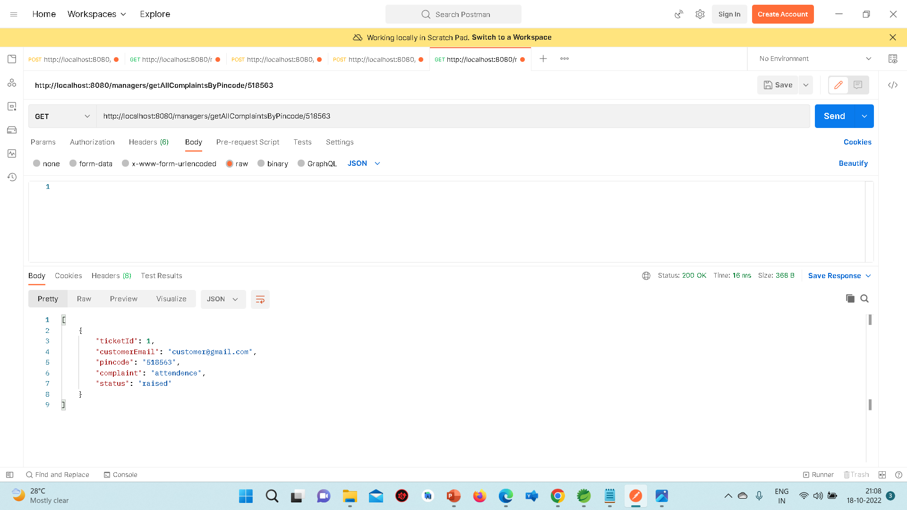

Slide 28
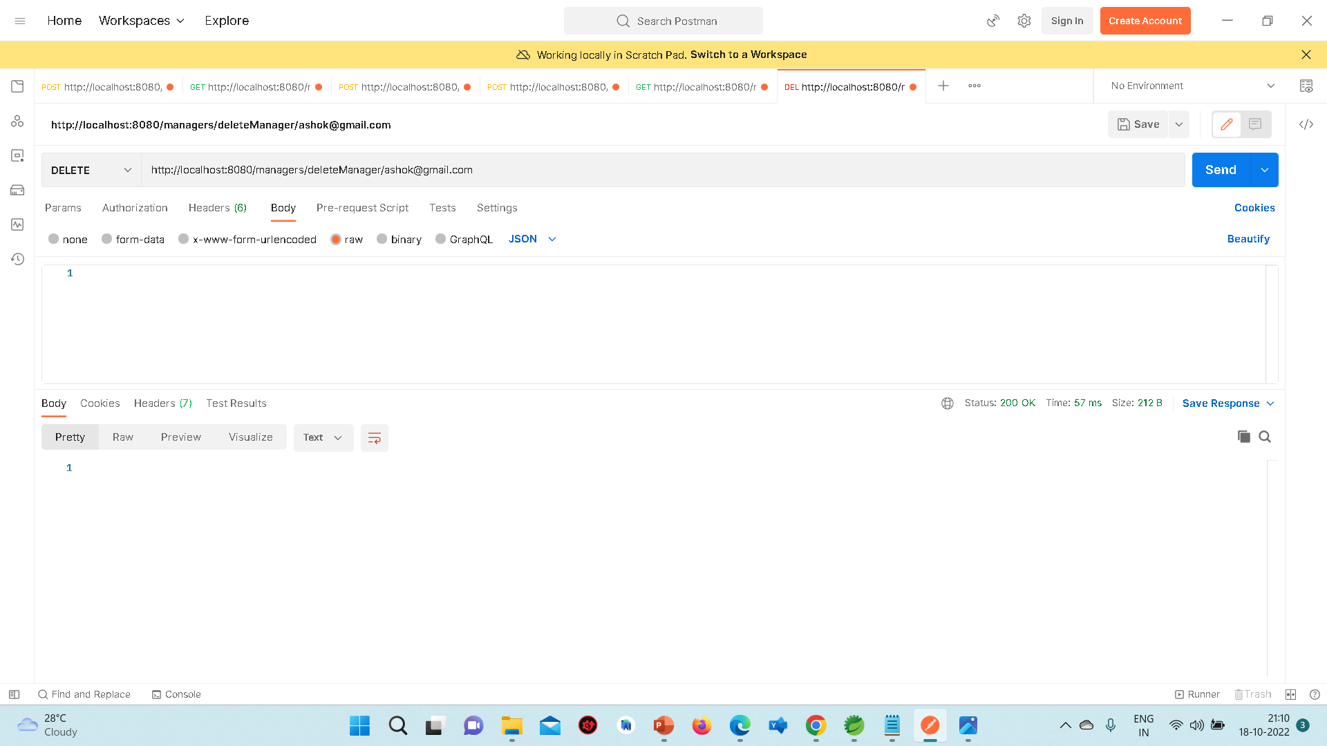

Slide 29
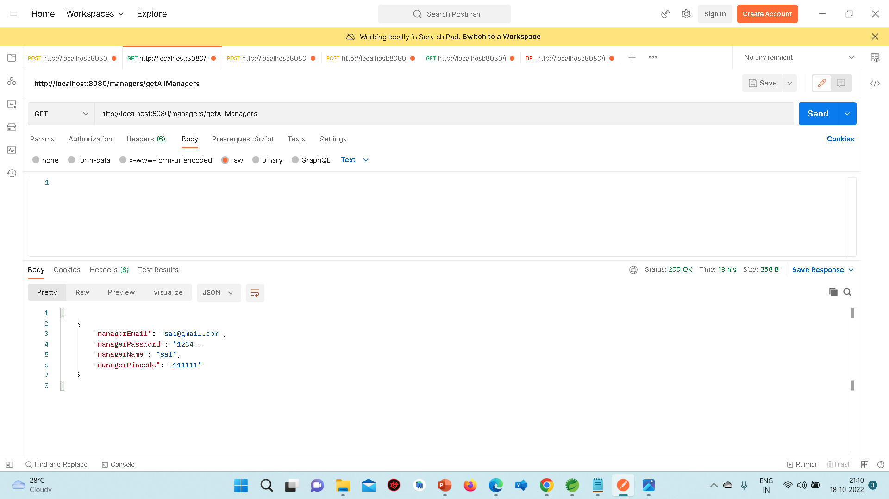

Slide 30
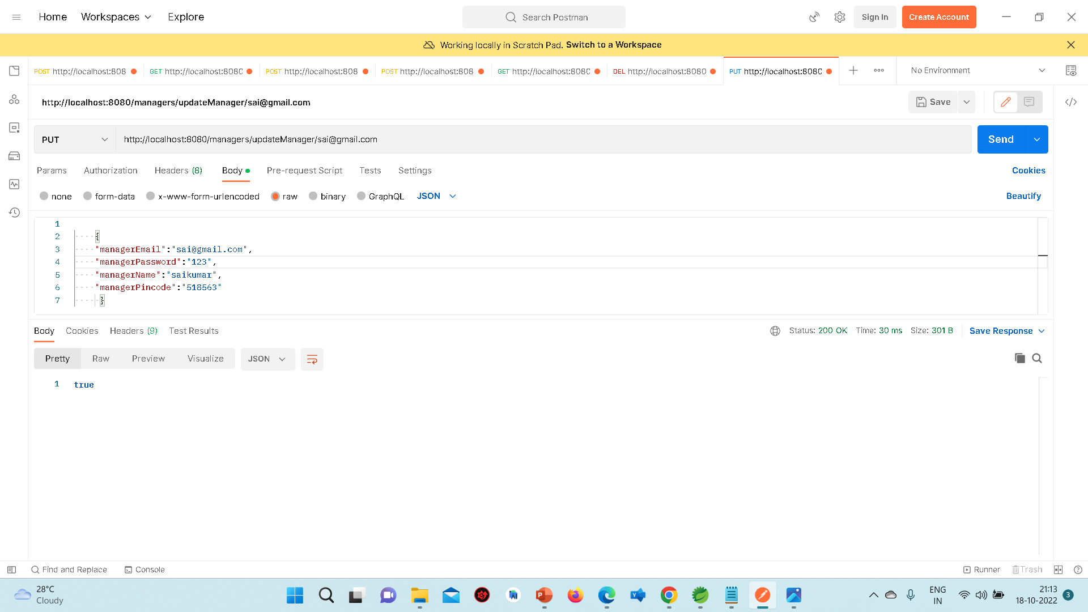

Slide 31
Engineers Module
Engineers should be able to login and logout. Once logged in he/she view the complaints based on the individual customer and work on complaints (Offline activities) and assign the new status and mark the ticket status appropriately and view the customer’s feedback
The Redressal System enables the engineers to login to the portal and view the complaints raised by the customers that are assigned by the manager and pick the tickets assigned to them and assign it the status of ‘WIP”, (work on the case, which is dependent on the type of problem and resolve) and update the status as ‘RESOLVED’. In case they are not able to resolve the issue at their end, they can remark that this needs to be reassigned to Field Workers in case of a cable fault or at the customers’ site, and flag it as ‘ESCALATED”.

Slide 32
ENGINEER MENU-FUNCTIONALITY
ENGINEER MENU
LOGIN
REGISTER
STATUS
Engineer Email
Engineer Password
Engineer Email
Engineer Password
Engineer Name
Ticket Id
Customer Email
Complaint
Pincode
Status

Slide 33
MANAGER-ENGINEER-CUSTOMER-SCHEMA
ENGINEER REGISTER
Engineer Email
Engineer Password
Engineer Name
ENGINEER LOGIN
Engineer Email
Engineer Password
Manager assigned ticket to engineer
VIEW FEEDBACKS
Feedback Id
Ticket Id
Customer Email
Feedback
VIEW COMPLAINTS
Ticket Id
Customer Email
Complaint
Pincode
New Status

Slide 34
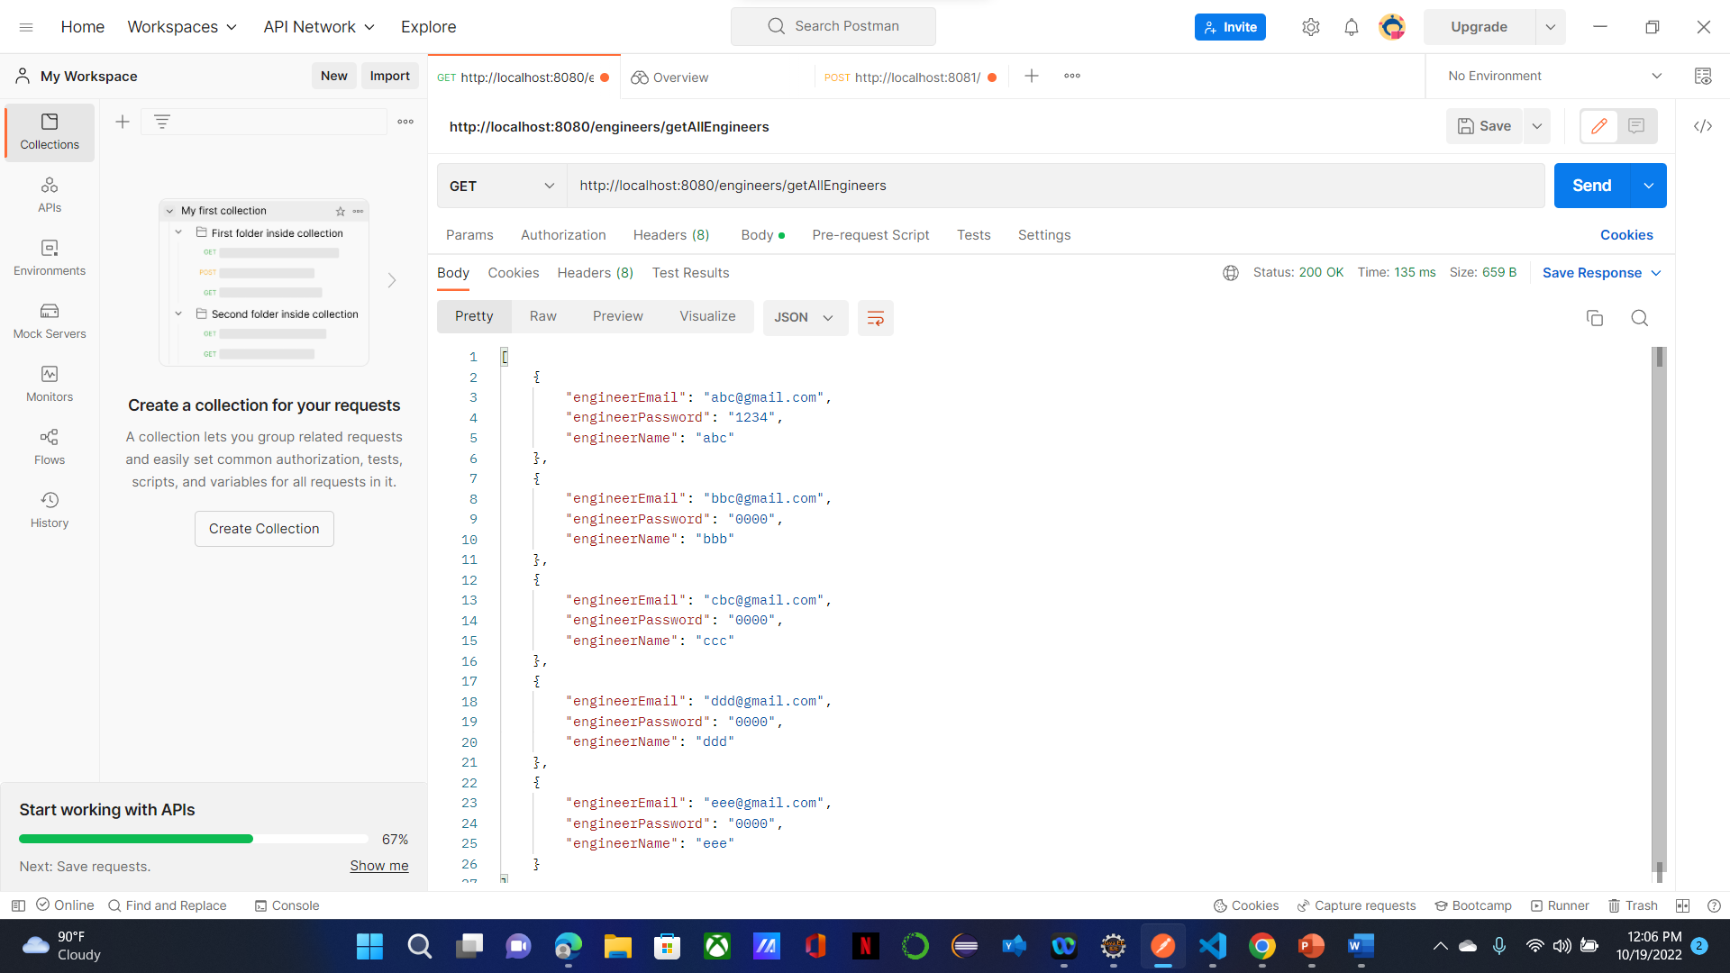
Functional Testing – Engineer Module

Slide 35
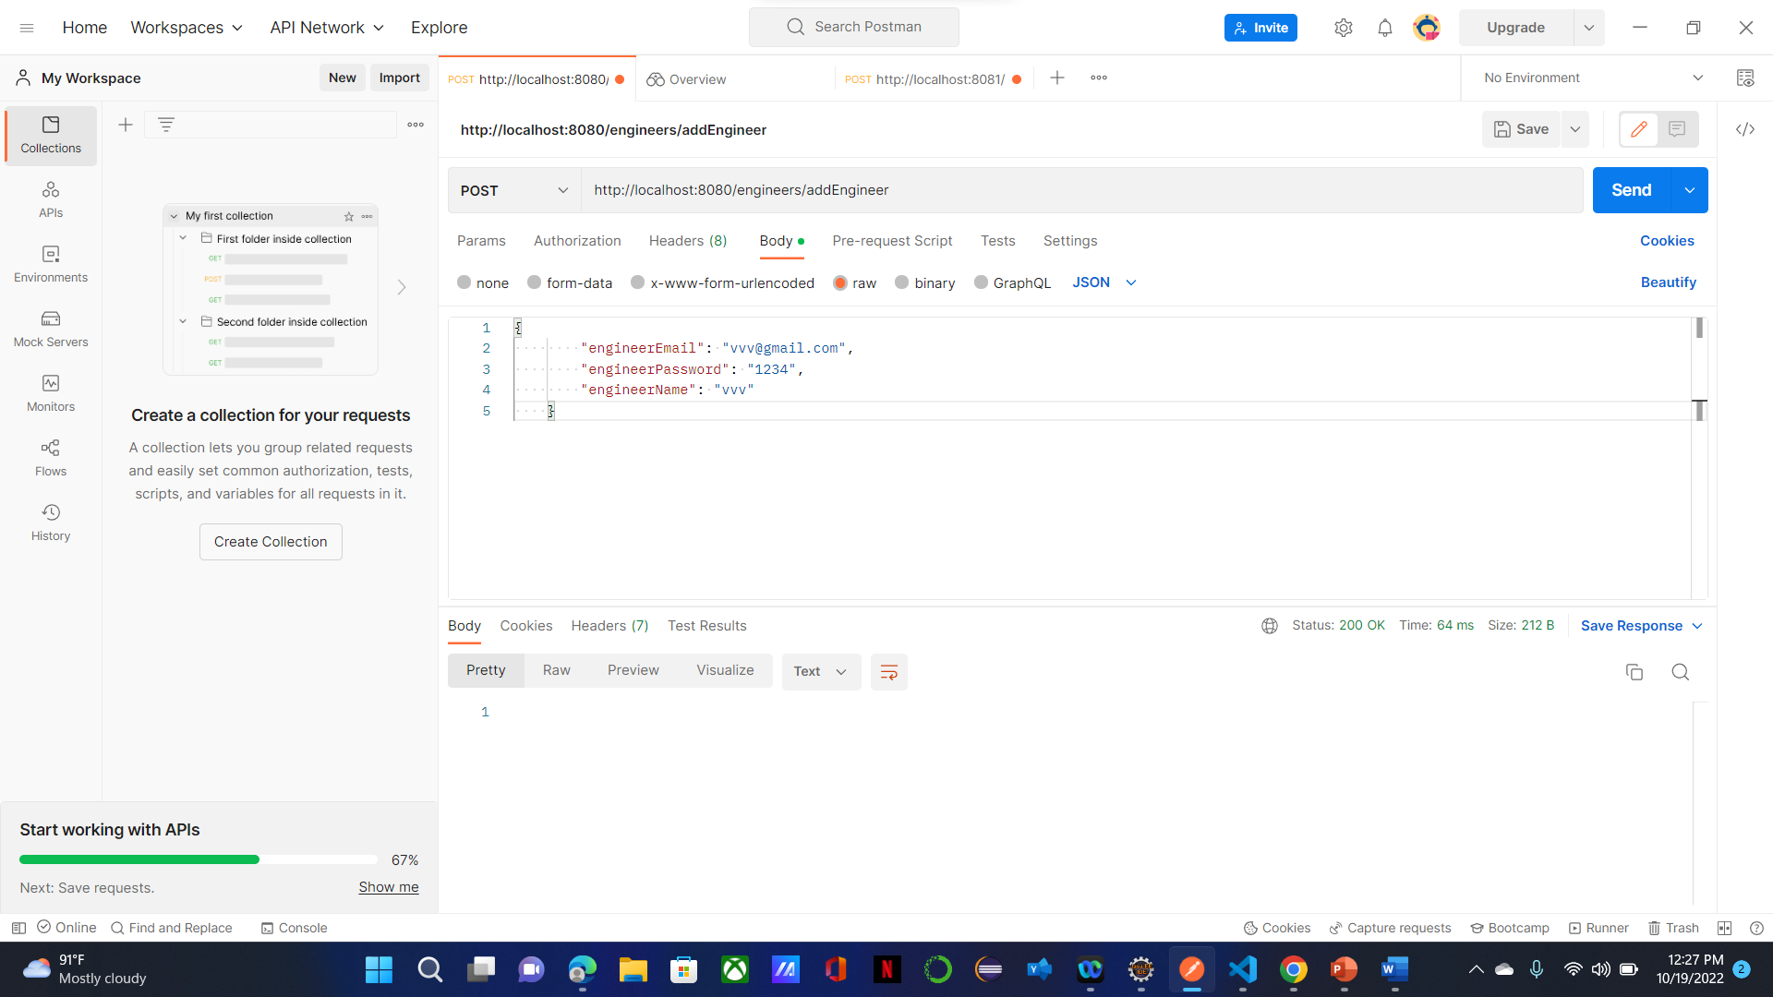

Slide 36
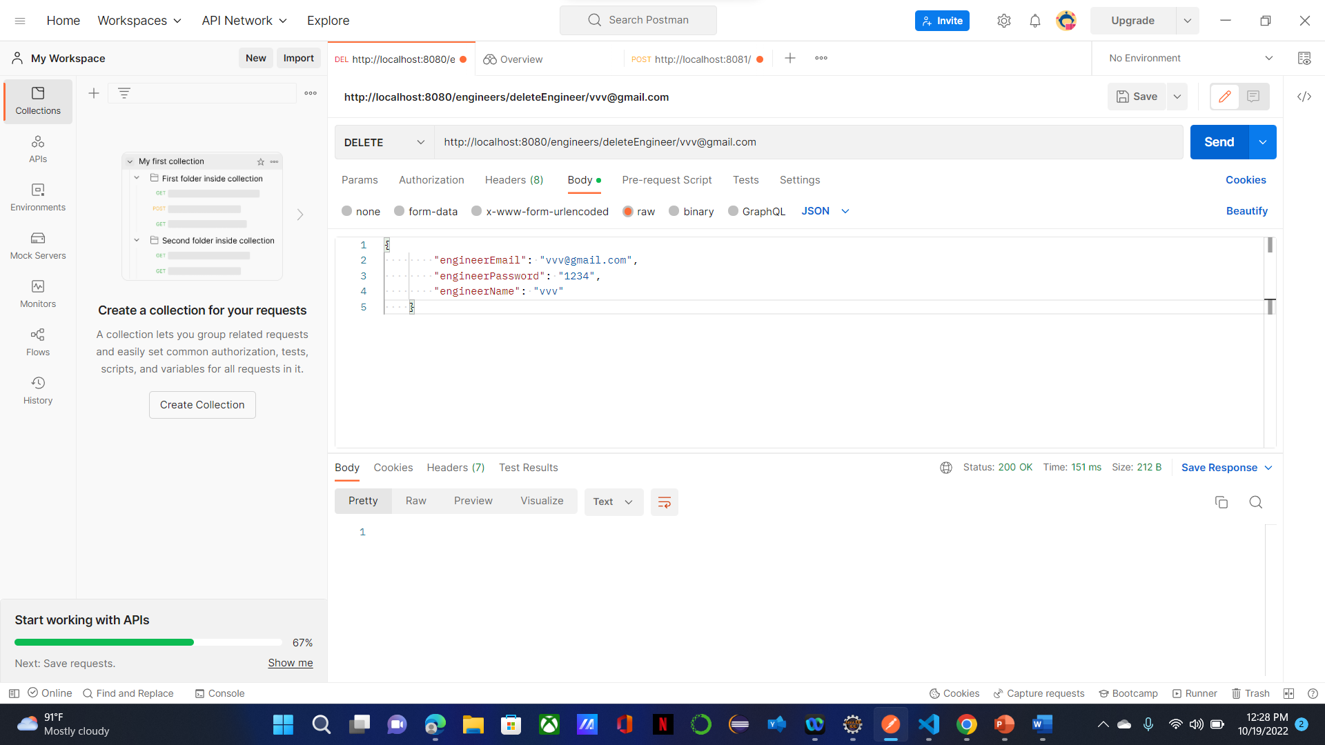

Slide 37
Benefits
Is an excellent way to improve your customers' experience with your support team because it makes the entire service request process more efficient.
User Friendly application
Easier way to recognize and sort the issue
Positive customer service experience makes them more likely to make a further purchase

Slide 38
Conclusion
This project is designed to meet the requirement of filing complaints and feedback of the service.
We have designed the project to provide user with easy application of service .
This system has been developed with much care and free of errors and at the same time it is efficient and less time consuming.
This system is developed to give a rich customer satisfaction experience.
Finally the customer can give there valuable feedback or else even file a complaint of the service provided in a easy and efficient manner .

Slide 39
Thank You !!

